Slide 1
Protocol Layer

Slide 2
一、实验目的
1. 学会通过Wireshark获取各协议层的数据包
2. 掌握协议层数据包结构
3. 分析协议开销

Slide 3
二、实验设备、环境
1. Wireshark v2.0.2
2.Windows操作系统
3.wget工具

Slide 4
三、实验内容——获取协议层的数据包
1.打开命令行，输入：wget http://www.baidu.com. 观察到 OK为止。
2.启动Wireshark，在菜单栏的捕获->选项中进行设置，选择已连接的以太网，设置捕获过滤器为tcp port 80，将混杂模式设为关闭,勾选 enable network name resolution.然后开始捕获.
3.点开命令行，重新输入:wget http://www.baidu.com
4.打开Wireshark， 停止捕获。

Slide 5
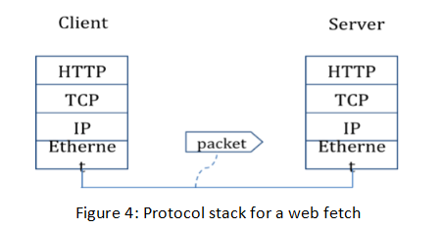
三、实验模型

Slide 6
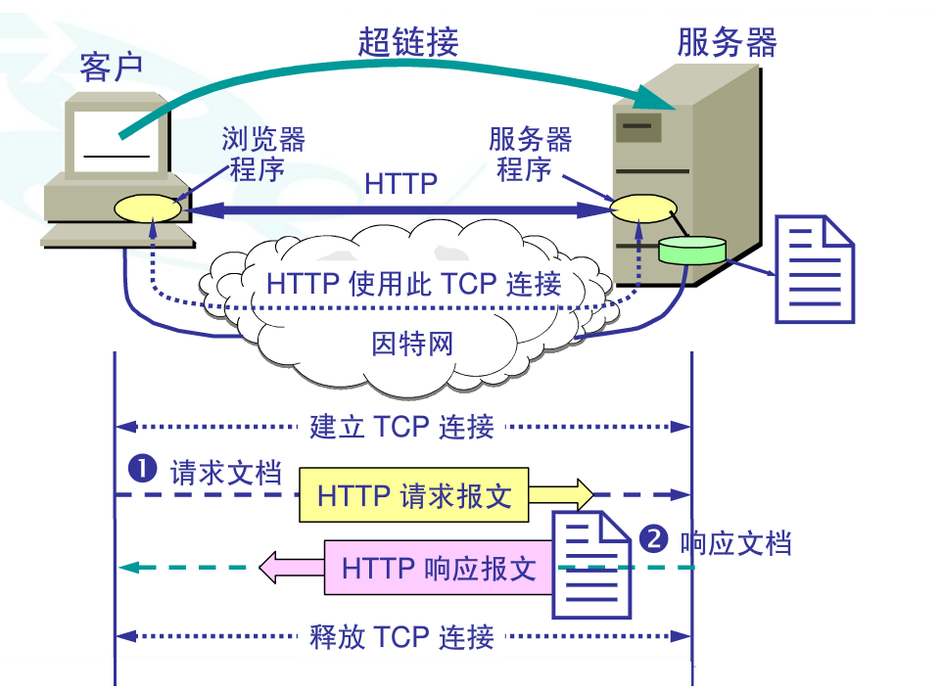
三、实验模型（http协议的操作过程）

Slide 7
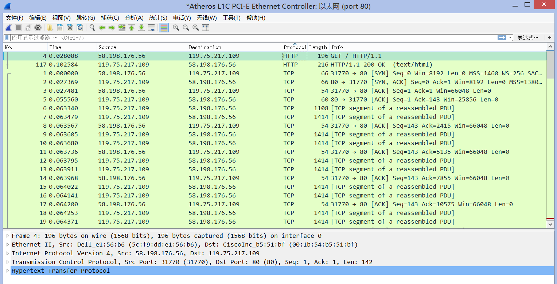
三、实验内容——绘制数据包结构
1.根据实验结构，分析Http GET协议包的内容。
2. 分析并且绘制协议包。

Slide 8
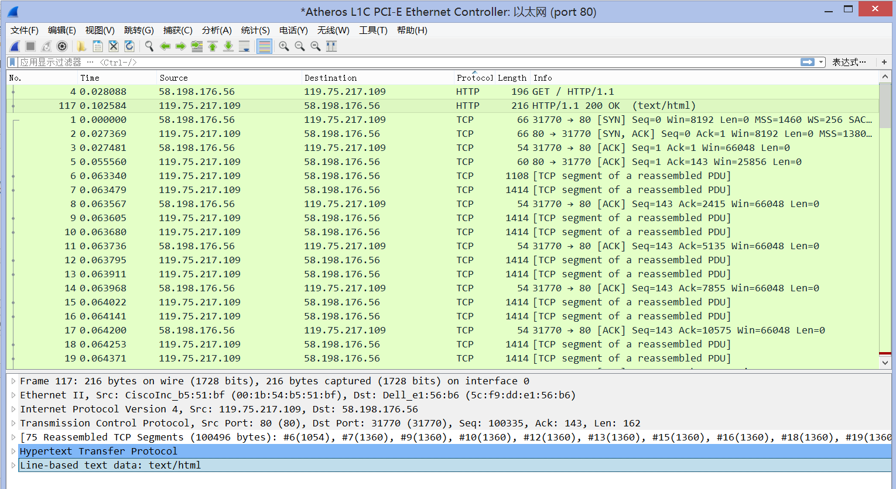
三、实验内容——分析协议开销
1.根据实验结构，分析Http应用协议额外开销。
2. 估计上面捕获的Http协议的额外开销。

Slide 9
三、实验内容——分析解复用键
观察下载的以太网和IP包头部信息回答下面问题：
1.以太网头部中哪一部分是解复用键并且告知它的下一个高层指的是IP，在这一包内哪一个值可以表示IP？
2.IP头部中哪一部分是解复用键并且告知它的下一一个高层指的是TCP，在这一包内哪一个值可以表示TCP？

Slide 10
四、问题讨论
Look at a short TCP packet that carries no higher-layer data. To what entity is this packet destined? After all, if it carries no higher-layer data then it does not seem very useful to a higher layer protocol such as HTTP!
In a classic layered model, one message from a higher layer has a header appended by the lower layer and becomes one new message. But this is not always the case. Above, we saw a trace in which the web response (one HTTP message comprised of an HTTP header and an HTTP payload) was converted into multiple lower layer messages (being multiple TCP packets). Imagine that you have drawn the packet structure (as in step 2) for the first and last TCP packet carrying the web response. How will the drawings differ?
In the classic layered model described above, lower layers append headers to the messages passed down from higher layers. How will this model change if a lower layer adds encryption?
In the classic layered model described above, lower layers append headers to the messages passed down from higher layers. How will this model change if a lower layer adds compression?

Slide 11
The end

